Slide 1

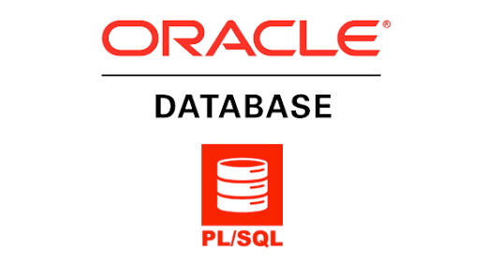
Oracle PL/SQL
PL/SQL Package and Trigger

Slide 2
Agenda
01
02
PL/SQL Package
PL/SQL Trigger

Slide 3
PL/SQL Package

Slide 4
PL/SQL Package
Package is a schema object and a collection of related PL/SQL types (variables, constants), cursors, procedures, and functions which are defined within a single context
Package
Package Specification
Package Body
You can define variables, constants, and exceptions
You can create a procedure, function, and a subprogram
Notes:
One of the world’s leading and pioneering e-commerce giant is eBay which facilitates both<Click event> business to business and <Click Event>business to consumer sales. eBay is a marketplace with a <Click Event> hundred and sixty-two million active customers and <Click Event> 25 million sellers. eBay wanted to make their data as efficient as possible for their buyers and sellers. As they have a total of eight hundred million listings on their site and 8.8 new million listings are being added every week.

Slide 5
PL/SQL Package: Advantages
You can create a package to store all related functions. Procedures are grouped together into a single unit called packages
Packages are reliable for granting privileges
All functions and procedures within a package can share variables among them
Packages support overloading of functions and procedures
Packages improve the performance of loading multiple objects into memory at once; therefore, subsequent calls to related programs do not require a physical I/O
Notes:
One of the world’s leading and pioneering e-commerce giant is eBay which facilitates both<Click event> business to business and <Click Event>business to consumer sales. eBay is a marketplace with a <Click Event> hundred and sixty-two million active customers and <Click Event> 25 million sellers. eBay wanted to make their data as efficient as possible for their buyers and sellers. As they have a total of eight hundred million listings on their site and 8.8 new million listings are being added every week.

Slide 6
PL/SQL Package: Syntax
Defining Package Specification Syntax
CREATE [OR REPLACE] PACKAGE package_name
IS | AS
[variable_declaration ...]
[constant_declaration ...]
[exception_declaration ...]
[cursor_specification ...]
[PROCEDURE [Schema..] procedure_name
[ (parameter {IN,OUT,IN OUT} datatype [,parameter]) ]
]
[FUNCTION [Schema..] function_name
[ (parameter {IN,OUT,IN OUT} datatype [,parameter]) ]
RETURN return_datatype
]
END [package_name];
Notes:
One of the world’s leading and pioneering e-commerce giant is eBay which facilitates both<Click event> business to business and <Click Event>business to consumer sales. eBay is a marketplace with a <Click Event> hundred and sixty-two million active customers and <Click Event> 25 million sellers. eBay wanted to make their data as efficient as possible for their buyers and sellers. As they have a total of eight hundred million listings on their site and 8.8 new million listings are being added every week.

Slide 7
PL/SQL Package: Syntax
Creating Package Body Syntax
[FUNCTION [Schema..] function_name
[ (parameter [,parameter]) ]
RETURN return_datatype
IS | AS
variable declarations;
constant declarations;
BEGIN
statement(s);
EXCEPTION
WHEN ...
END
]
[EXCEPTION
WHEN built-in_exception_name_1 THEN
User defined statement (action) will be taken;
]
END;
/
CREATE [OR REPLACE] PACKAGE BODY package_name
IS | AS
[private_variable_declaration ...]
[private_constant_declaration ...]
BEGIN
[initialization_statement]
[PROCEDURE [Schema..] procedure_name
[ (parameter [,parameter]) ]
IS | AS
variable declarations;
constant declarations;
BEGIN
statement(s);
EXCEPTION
WHEN ...
END
]
Notes:
One of the world’s leading and pioneering e-commerce giant is eBay which facilitates both<Click event> business to business and <Click Event>business to consumer sales. eBay is a marketplace with a <Click Event> hundred and sixty-two million active customers and <Click Event> 25 million sellers. eBay wanted to make their data as efficient as possible for their buyers and sellers. As they have a total of eight hundred million listings on their site and 8.8 new million listings are being added every week.

Slide 8
PL/SQL Package: Example
EMP_NO | EMP_NAME | EMP_DEPT | EMP_SALARY
1 | Forbs Ross | Web Developer | 45k
2 | Marks Jems | Program Developer | 38k
3 | Saulin | Program Developer | 34k
4 | Zenia Sroll | Web Developer | 42k
Notes:
One of the world’s leading and pioneering e-commerce giant is eBay which facilitates both<Click event> business to business and <Click Event>business to consumer sales. eBay is a marketplace with a <Click Event> hundred and sixty-two million active customers and <Click Event> 25 million sellers. eBay wanted to make their data as efficient as possible for their buyers and sellers. As they have a total of eight hundred million listings on their site and 8.8 new million listings are being added every week.

Slide 9
PL/SQL Package: Example
Defining Package Specification
REATE or REPLACE PACKAGE pkg1
IS | AS
PROCEDURE pro1
(no in number, name out varchar2);
FUNCTION fun1
(no in number)
RETURN varchar2;
END;
/
Notes:
One of the world’s leading and pioneering e-commerce giant is eBay which facilitates both<Click event> business to business and <Click Event>business to consumer sales. eBay is a marketplace with a <Click Event> hundred and sixty-two million active customers and <Click Event> 25 million sellers. eBay wanted to make their data as efficient as possible for their buyers and sellers. As they have a total of eight hundred million listings on their site and 8.8 new million listings are being added every week.

Slide 10
PL/SQL Package: Example
Defining Package Body
CREATE or REPLACE PACKAGE BODY pkg1
IS
PROCEDURE pro1(no in number,info our varchar2)
IS
BEGIN
SELECT * INTO temp FROM emp1 WHERE eno = no;
END;
FUNCTION fun1(no in number) return varchar2
IS
name varchar2(20);
BEGIN
SELECT ename INTO name FROM emp1 WHERE eno = no;
RETURN name;
END;
END;
/
Notes:
One of the world’s leading and pioneering e-commerce giant is eBay which facilitates both<Click event> business to business and <Click Event>business to consumer sales. eBay is a marketplace with a <Click Event> hundred and sixty-two million active customers and <Click Event> 25 million sellers. eBay wanted to make their data as efficient as possible for their buyers and sellers. As they have a total of eight hundred million listings on their site and 8.8 new million listings are being added every week.

Slide 11
PL/SQL Package: Example
Program Calling Package
Result
DECLARE
no number := &no;
name varchar2(20);
BEGIN
pkg1.pro1(no,info);
dbms_output.put_line('Procedure Result');
dbms_output.put_line(info.eno||' '||
info.ename||' '||
info.edept||' '||
info.esalary||' '||);
dbms_output.put_line('Function Result');
name := pkg1.fun1(no);
dbms_output.put_line(name);
END;
/
SQL>@pkg_prg
no number &n=2
Procedure Result
2 marks jems Program Developer 38K
Function Result
marks jems
PL/SQL procedure successfully completed.
Notes:
One of the world’s leading and pioneering e-commerce giant is eBay which facilitates both<Click event> business to business and <Click Event>business to consumer sales. eBay is a marketplace with a <Click Event> hundred and sixty-two million active customers and <Click Event> 25 million sellers. eBay wanted to make their data as efficient as possible for their buyers and sellers. As they have a total of eight hundred million listings on their site and 8.8 new million listings are being added every week.

Slide 12
PL/SQL Package: Alter
You can update the package code by just recompiling the package body.
Syntax
Example
ALTER PACKAGE package_name COMPILE BODY;
SQL>ALTER PACKAGE pkg1 COMPILE BODY;
Package body Altered

Slide 13
PL/SQL Package: Drop
You can drop a package using the DROP PACKAGE statement.
Syntax
Example
DROP PACKAGE package_name;
SQL>DROP PACKAGE pkg1;
Package dropped

Slide 14
PL/SQL Triggers

Slide 15
PL/SQL Triggers
Oracle engine get invoked automatically whenever a specified event occurs.
Trigger is stored into the database and invoked repeatedly, when specific conditions match.
You can change the trigger mode to activate/deactivate, but you can't explicitly run
Trigger automatically associates with the DML statement; when the DML statement executes, trigger implicitly executes
You can create trigger using the CREATE TRIGGER statement. If trigger is activated, it fires the DML statement, and if trigger is deactivated it can't fire
Notes:
One of the world’s leading and pioneering e-commerce giant is eBay which facilitates both<Click event> business to business and <Click Event>business to consumer sales. eBay is a marketplace with a <Click Event> hundred and sixty-two million active customers and <Click Event> 25 million sellers. eBay wanted to make their data as efficient as possible for their buyers and sellers. As they have a total of eight hundred million listings on their site and 8.8 new million listings are being added every week.

Slide 16
Components of Triggers
A Triggering SQL Statement
Trigger Action
Trigger Restriction
SQL DML (INSERT, UPDATE, and DELETE) statements that implicitly call trigger to execute
When a triggering SQL statement is executed, trigger automatically calls and PL/SQL trigger blocks the execution
We can specify the condition inside a trigger as when the trigger is to be fired
Notes:
One of the world’s leading and pioneering e-commerce giant is eBay which facilitates both<Click event> business to business and <Click Event>business to consumer sales. eBay is a marketplace with a <Click Event> hundred and sixty-two million active customers and <Click Event> 25 million sellers. eBay wanted to make their data as efficient as possible for their buyers and sellers. As they have a total of eight hundred million listings on their site and 8.8 new million listings are being added every week.

Slide 17
Types of Triggers
Types of Triggers
AFTER
Trigger
ROW
Trigger
Statement
Trigger
Combination
Trigger
Before Statement
Trigger
Before Row
Trigger
After Row
Trigger
BEFORE
Trigger
After Statement
Trigger
Notes:
One of the world’s leading and pioneering e-commerce giant is eBay which facilitates both<Click event> business to business and <Click Event>business to consumer sales. eBay is a marketplace with a <Click Event> hundred and sixty-two million active customers and <Click Event> 25 million sellers. eBay wanted to make their data as efficient as possible for their buyers and sellers. As they have a total of eight hundred million listings on their site and 8.8 new million listings are being added every week.

Slide 18
PL/SQL Triggers: Syntax
CREATE [OR REPLACE] TRIGGER trigger_name
BEFORE | AFTER
[INSERT, UPDATE, DELETE [COLUMN NAME..]
ON table_name
Referencing [ OLD AS OLD | NEW AS NEW ]
FOR EACH ROW | FOR EACH STATEMENT [ WHEN Condition ]
DECLARE
[declaration_section
variable declarations;
constant declarations;
]
BEGIN
[executable_section
PL/SQL execute/subprogram body
]
EXCEPTION
[exception_section
PL/SQL Exception block
]
END;
Syntax Description
CREATE [OR REPLACE] TRIGGER trigger_name
Creates a trigger with the given name. If it already exists, overwrite the existing trigger with the same defined name
BEFORE | AFTER
Indicates when the trigger gets fired. BEFORE trigger executes before the statement executes. AFTER trigger executes after the statement executes
[INSERT, UPDATE, DELETE [COLUMN NAME]
Determines the performing trigger event. You can define more than one triggering event separated by the OR keyword
ON table_name
Assign a table name to the performing trigger event
Referencing [ OLD AS OLD | NEW AS NEW ]
Give referencing to old and new values of data. :old means to use the existing row to perform the event and :new means to execute a new row to perform the event. You can set referencing names using old names or new user-defined names You can't reference old values when inserting a record or new values when deleting a record, because It does not exist
FOR EACH ROW | FOR EACH STATEMENT
Trigger must be fired when each row gets affected (ROW Trigger) and be fired only once when the entire SQL statement is executed (STATEMENT Trigger)
WHEN Condition
(Optional) Use only for row-level trigger. Trigger gets fired when a specified condition is satisfied.

Slide 19
PL/SQL Triggers: Example
Inserting a Trigger
CREATE or REPLACE TRIGGER trg1
BEFORE
INSERT ON emp1
FOR EACH ROW
BEGIN
:new.ename := upper(:new.ename);
END;
/

Slide 20
PL/SQL Triggers: Example
Restriction to Deleting a Trigger
CREATE or REPLACE TRIGGER trg1
AFTER
DELETE ON emp1
FOR EACH ROW
BEGIN
IF :old.eno = 1 THEN
raise_application_error(-20015, 'You can't delete this row');
END IF;
END;
/
Result
SQL>delete from emp1 where eno = 1;
Error Code: 20015
Error Name: You can't delete this row

Slide 21
Quiz

Slide 22
Quiz 1
What is the syntax for disabling a trigger?
A
DISABLE TRIGGER trigger_name;
B
ALTER TRIGGER trigger_name DISABLE;
C
ALTER TRIGGER DISABLE trigger_name;
D
Both a, b and c can be used

Slide 23
Quiz 1
What is the syntax for disabling a trigger?
A
DISABLE TRIGGER trigger_name;
B
ALTER TRIGGER trigger_name DISABLE;
C
ALTER TRIGGER DISABLE trigger_name;
D
Both a, b and c can be used

Slide 24
Quiz 2
Select the VALID trigger type(s)?
A
UPDATE row trigger
B
DELETE row trigger
C
INSERT row trigger
D
AFTER statement trigger

Slide 25
Answer 2
Select the VALID trigger type(s)?
A
UPDATE row trigger
B
DELETE row trigger
C
INSERT row trigger
D
AFTER statement trigger

Slide 26
Quiz 3
All objects placed in a package specification are called
A
Public objects
B
Private objects
C
None of the above
D
All of the above

Slide 27
Answer 3
All objects placed in a package specification are called
A
Public objects
B
Private objects
C
None of the above
D
All of the above

Slide 28
Quiz 4
Is it possible to open a cursor which is in a Package in another procedure ?
A
Yes
B
No

Slide 29
Answer 4
Is it possible to open a cursor which is in a Package in another procedure ?
A
Yes
B
No

Slide 30
Quiz 5
Is it possible to use Transactional control statements in Database Triggers ?
A
Yes
B
No

Slide 31
Answer 5
Is it possible to use Transactional control statements in Database Triggers ?
A
Yes
B
No

Slide 32
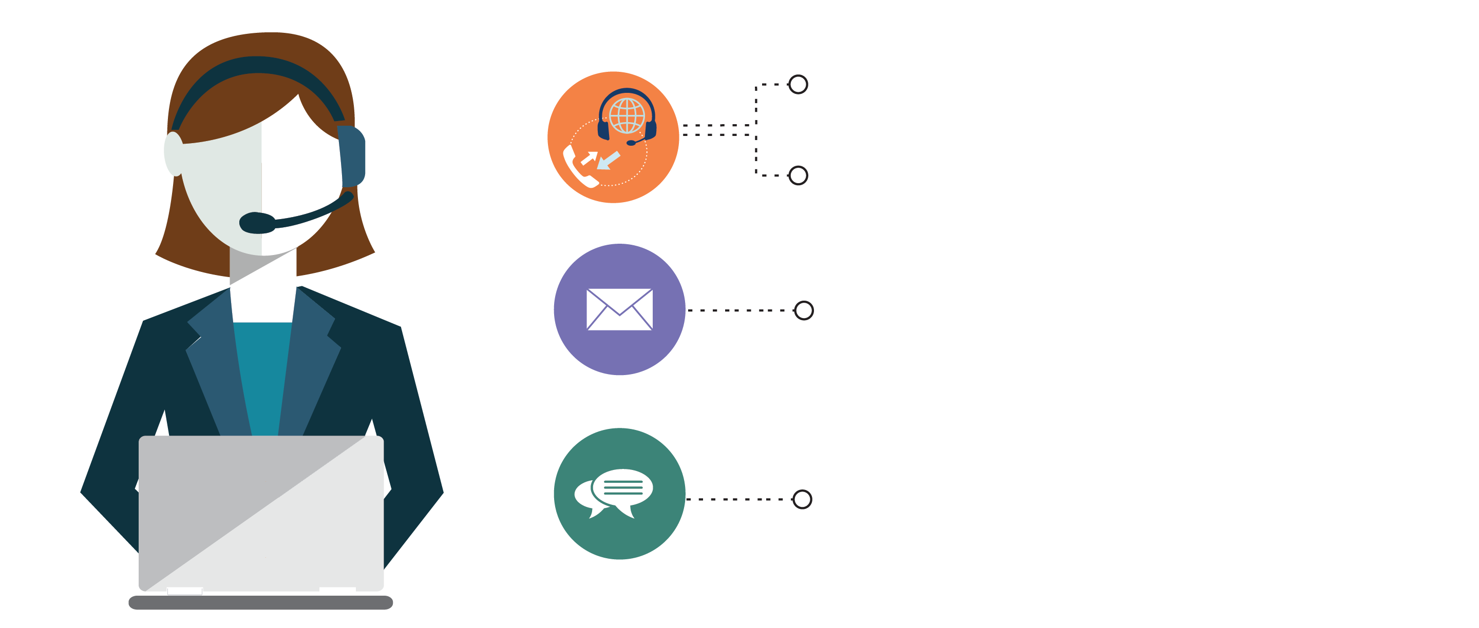
India: +91-7847955955
US: 1-800-216-8930 (TOLL FREE)
sales@intellipaat.com
24/7 Chat with Our Course Advisor
Notes:
Thank you!

